Slide 1
Professional Skills Course
Project Management – Thanksgiving Dinner
Instructor:
Eric White
Taos Mountain
Fall 2016

Slide 2
Step 1: Define your scope.
Step 2: Make a plan.
Step 3: Map out your timeline.
Step 4: Assess the risks.
Step 5: Work with your stakeholders.
Step 6: Collaborate with your team.
Step 7: Don’t forget the retrospective.
https://www.wrike.com/blog/project-managers-guide-to-surviving-thanksgiving/

Slide 3
Step 1: Define your scope.
  How big of a celebration do you want? How many guests? Do you want to break out the good china or would you rather have a casual, “grab a plate and have at it” meal? Is dinner served at precisely 4 pm, or would you rather have an all-day, “drop in and grab a piece of pie” affair?
  Project Manager’s Tip: Don’t do more than you need to. If your guests aren’t going to notice or care about hand-lettered, gold-foiled name cards, don’t waste the time, money, and effort creating them.

Slide 4
Step 2: Make a plan.
  Sort out your menu, whom you’re going to invite, who’s bringing what, figure out the seating chart, create your shopping list.
  Project Manager’s Tip: Be realistic. Don’t plan a 6-course gourmet feast if you’ve never peeled a potato before.

Slide 5
Step 3: Map out your timeline.
  If you value your sanity, you can’t just fly by the seat of your pants — you need an organized itinerary. Schedule what you’re going to make ahead of time and when. Figure out what time everything needs to go in the oven and in what order for it all to come out at just the right time.
  Project Manager’s Tip: Do the risky stuff first, if possible. If you’ve never made homemade cranberry sauce, don’t try it for the first time an hour before the turkey’s done. It’ll be less stressful for you and you’ll probably get better results if you buffer in some extra time around any uncertainties.

Slide 6
Step 4: Assess the risks.
  What’s the likelihood your fad-diet-obsessed cousin will be eating Paleo this year? What if someone drops the gravy boat? What do you need a backup plan for, and what can you shrug off?
  Project Manager’s Tip: Remember that not everything is worth worrying about. If a risk or issue won’t have a major impact on your day, don’t bother bending over backwards to address it.

Slide 7
Step 5: Work with your stakeholders.
  Ah, family. They’re a lovable bunch, but they can be a handful. Your sister-in-law claims she makes the world’s best pumpkin pie, but that’s been your mom’s territory for ages. Share your planned menu and let people pick what they’d like to bring. If conflicts arise, be flexible when you can! After all, who’s going to complain about two pumpkin pies?

Slide 8
Step 6: Collaborate with your team.
  Most of all, a great Thanksgiving takes teamwork. You’ll need to delegate certain tasks to other people, or count on others to help you if you want to pull off a successful holiday. Besides, people usually want to help out!
  Project Manager’s Tip: Just because you’re the “manager,” doesn’t mean everything has to be done your way. If your sister wants to buck convention and bring a turducken, why not? You never know — it could be the start of a fun new tradition!

Slide 9
Step 7: Don’t forget the retrospective.
  At the end of the day, when your family is drowsy from an overload of tryptophan and carbs, your sink is piled high with gravy-crusted dishes, and the candles are burning low, take a few minutes to reflect on the day and everything that went well.
  Project Manager’s Tip: Focus on the highlights! Everyone worked hard to make the day successful, so remember to say thank you. It’s what the whole day is about! It’ll help you fully appreciate a job well done.

Slide 10
What are the dependencies for a Thanksgiving dinner? Before you can put the turkey in the oven, you have to have made the stuffing,” explains Faye Newsham in Govloop. “To make gravy the completed turkey is necessary to provide the pan drippings. These are ‘dependencies’ or tasks that depend on the completion of another task in order to begin. The length of time required to complete these three tasks is known as the ‘critical path.’”
https://www.laserfiche.com/simplicity/thanksgiving-dinner-project-management-way/

Slide 11
The single task that takes the longest is cooking the turkey. What other tasks should you consider necessary to preparing the turkey? Let’s assume we are stuffing the turkey and making gravy from scratch. This means we should consider the time to make each item. Before you can put the turkey in the oven, you have to have made the stuffing. To make gravy the completed turkey is necessary to provide the pan drippings. These are ‘dependencies’ or tasks that depend on the completion of another task in order to begin. The length of time required to complete these three tasks is known as the ‘critical path.’
The critical path indicates the single group of tasks that are required to complete the project and take the longest. Note that baking the pie is not included in this list because it can share space in the oven, be started after the turkey is removed from the oven, or be prepared ahead of time. Mashed potatoes, carrots, green beans, and tossed salad can all be prepared while the turkey is cooking using equipment separate from the oven. The sweet potato casserole may impact our critical path if we can’t fit in in the oven with the turkey or prepare it ahead of time as it is a side-dish serve with the meal instead of pie which is served at the end.
https://www.govloop.com/community/blog/did-you-know-that-thanksgiving-turkey-dinner-is-a-project-planning-training-tool/

Slide 12
Example Thanksgiving Timelines:
http://www.thekitchn.com/the-10-day-thanksgiving-timeline-thanksgiving-guides-from-the-kitchn-212889
http://blog.williams-sonoma.com/expert-thanksgiving-tips/
http://www.realsimple.com/food-recipes/cooking-tips-techniques/thanksgiving-timeline-checklist
http://www.foodnetwork.com/holidays-and-parties/articles/thanksgiving-planning-guide.html
https://www.cooksillustrated.com/features/8130-thanksgiving-cooking-timeline

Slide 13
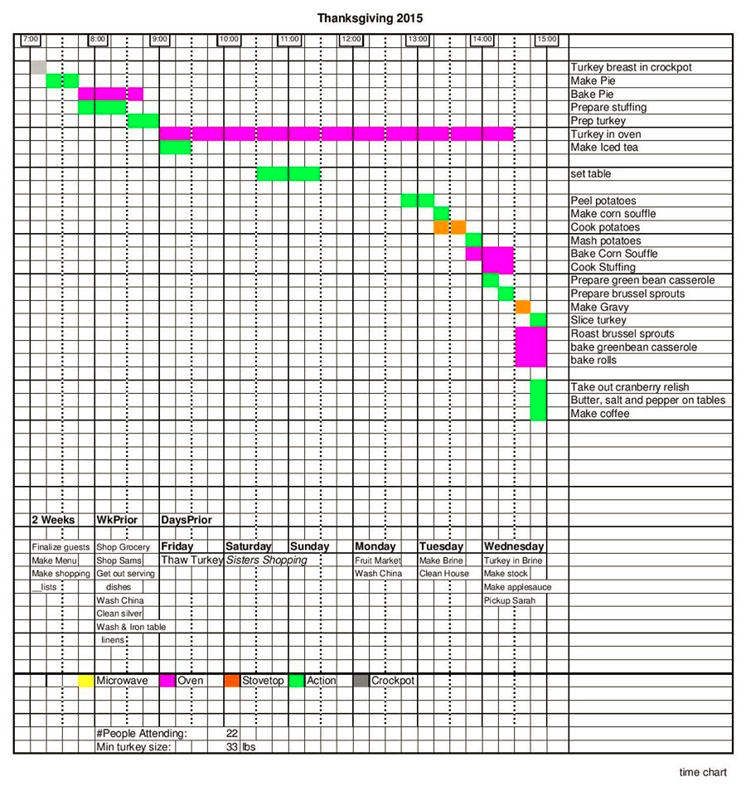
https://www.reddit.com/r/food/comments/3t6upb/how_my_mother_plans_for_thanksgiving_dinner/

Slide 14
Now it’s your turn!

